Slide 1

Advanced Topics in Economic Evaluation and Healthcare
Lecture #5: Deterministic Sensitivity Analysis

Slide 2
Lecture Overview
In this lecture we will discuss Deterministic Sensitivity Analysis. We will discuss
  What sensitivity analysis is.
  Types of Sensitivity Analysis
  Deterministic Sensitivity Analysis: One Way Analysis.
  Sensitivity Analysis with Multiple Comparators.
  Two Way sensitivity Analysis.
By the end of this lecture you should have a sense of deterministic sensitivity analysis and how it may support model results.

Slide 3
An Introduction to Sensitivity Analysis

Slide 4
What is Sensitivity Analysis
Sensitivity Analysis is the process of examining how change in different model inputs impact model output.
This is included as an important part of nearly every economic evaluation because decision analytic models are built upon Assumptions.
Some of these assumptions are (but not limited to):
  Assumptions about the nature of the clinical pathway.
  Assumptions about the risk of adverse events.
  Assumptions about the Costs and Effects in each health state.
  Assumptions about the relevant Clinical Comparators.
Our goal is to answer the following question:
how sensitive is the computed ICER to changes in each of these assumptions.

Slide 5
Types of Sensitivity Analysis
There are three type of sensitivity analysis:
  One-way sensitivity analysis.
  Two-way sensitivity analysis.
  Probabilistic sensitivity analysis.
The first two on this list are often grouped together and called Deterministic Sensitivity Analysis.
This is called deterministic because we will be directly in control of how much each input may change. (You may be asking whats the alternative? That’s Probabilistic Sensitivity Analysis which will be discussed next class)

Slide 6
What do we apply sensitivity analysis to?
There may be uncertainty about different parts of a model not limited to but including:
  Probability of events.
  Costs in each state of the model.
  Utilities in each state of a model.
Model structure remains unchanged only inputs change.
Ultimately we are interested in seeing how the variation in model impacts the computed ICER which defines the cost-effectiveness the drug or technology in question.

Slide 7
One Way Sensitivity Analysis

Slide 8
One-way Sensitivity Analysis
In one-way sensitivity analysis is when we vary a single model parameter at a time to determine its effect on the computed ICER.
The simplest way to do this, a “High” case where the parameter value is 50% larger than the base specification and a “Low” case when the parameter value is 50% lower from the base specification.
Note: in a one-way sensitivity analysis all other parameter values are held constant. This is done to determine the role each parameter plays.

Slide 9
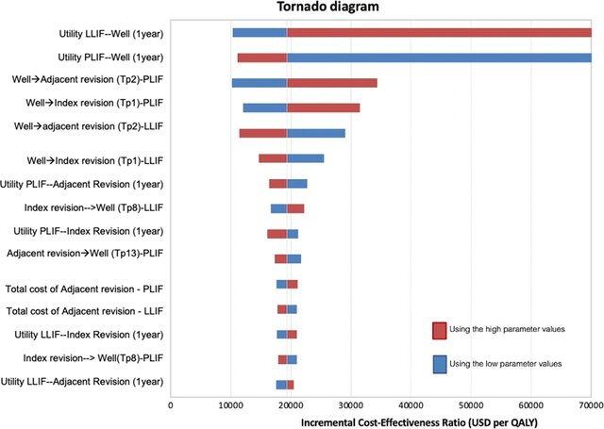
Tornado Diagrams
One of the two ways of presenting deterministic sensitivity analysis.
It displays the responsiveness each input has to variation in value for high and low cases with the more responsive parameters typically at the top with less responsive parameters closer to the bottom.
Researchers may want to display separate charts for costs and effects respectively in order to provide a comprehensive insight in the model’s sensitivity.
Figure from: Boonsirikamchai, W., Phisalpapra, P., Kositamongkol, C., Korwutthikulrangsri, E., Ruangchainikom, M., & Sutipornpalangkul, W. (2023). Lateral lumbar interbody fusion (LLIF) reduces total lifetime cost compared with posterior lumbar interbody fusion (PLIF) for single-level lumbar spinal fusion surgery: a cost-utility analysis in Thailand. Journal of orthopaedic surgery and research, 18(1), 115.

Slide 10
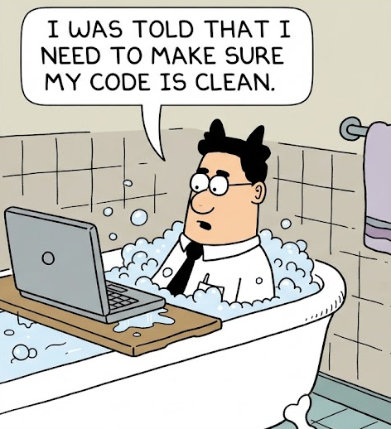
Cost Effectiveness “Model Hygiene”
When we do a sensitivity analysis in excel, we need to make sure our model parameters are in one sheet and computed results are in another.
YOU SHOULD NOT DEFINE ANY NEW VARIABLES WHEN YOU COMPUTE YOUR RESULTS JUST DEPEND ON OTHER RESULTS.
This way we can generate sensitivity analysis output directly.
While there are more comprehensive ways of conducting sensitivity analysis on each model parameter, all we are doing is just estimating the model multiple times under different specifications.

Slide 11
Sensitivity Analysis with Multiple Alternatives

Slide 12
Sensitivity Analysis with Alternate Baselines
Another class of sensitivity analysis is to use multiple comparators.
This involves adding more than one treatment arm to your model.
In a case where we are evaluating the cost effectiveness of treatment A we may compute two different ICERs, one using Treatment B as a control and one using Treatment C as a control.
We may also be curious about identifying the most cost effective treatment in a single analysis.
Treatment A
Treatment B
Treatment C

Slide 13

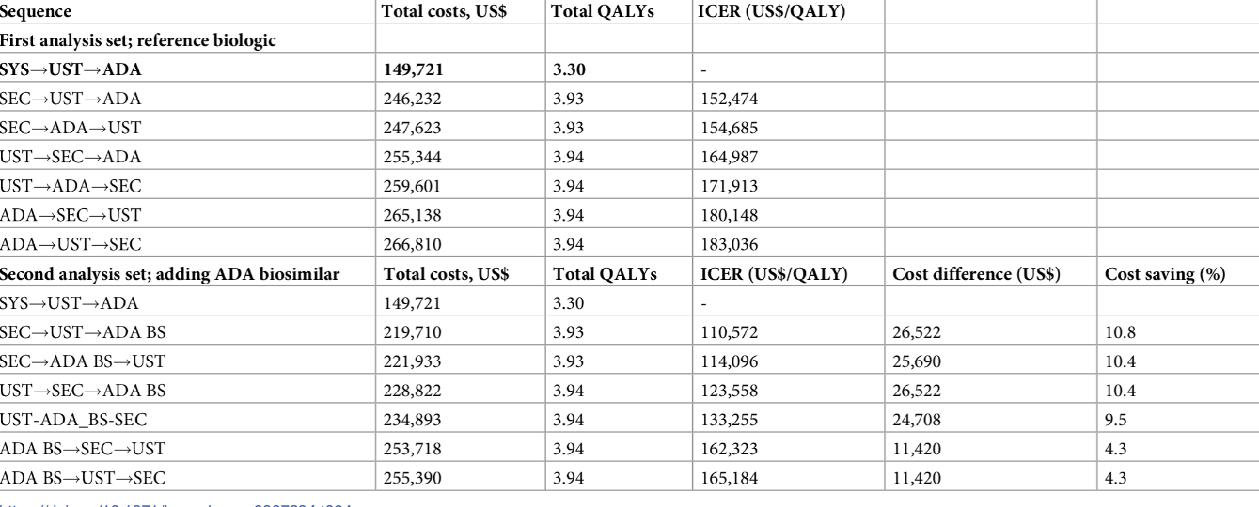
Seeing this in the literature
This paper examines the optimal sequencing of biologics for patients with moderate-to severe psoriasis.
It considers the cost effectiveness of 13 different possible sequences.
Azizam, N. A., Hussain, M., Nauenberg, E., Ang, W. C., Azzeri, A., & Smith, J. (2024). Cost-effectiveness analysis of biologic sequential treatments for moderate-to-severe psoriasis: A Malaysian healthcare system perspective. Plos one, 19(9), e0307234.

Slide 14
Seeing this in the literature
This paper examines the optimal sequencing of biologics for patients with moderate-to severe psoriasis.
It considers the cost effectiveness of 13 different possible sequences.
ICERS are produced based
On different assumptions
regarding the sequencing
Of treatments.
This generates a wide range
of ICER values which are
grounded in direct clinical
assumptions.
Azizam, N. A., Hussain, M., Nauenberg, E., Ang, W. C., Azzeri, A., & Smith, J. (2024). Cost-effectiveness analysis of biologic sequential treatments for moderate-to-severe psoriasis: A Malaysian healthcare system perspective. Plos one, 19(9), e0307234.

Slide 15
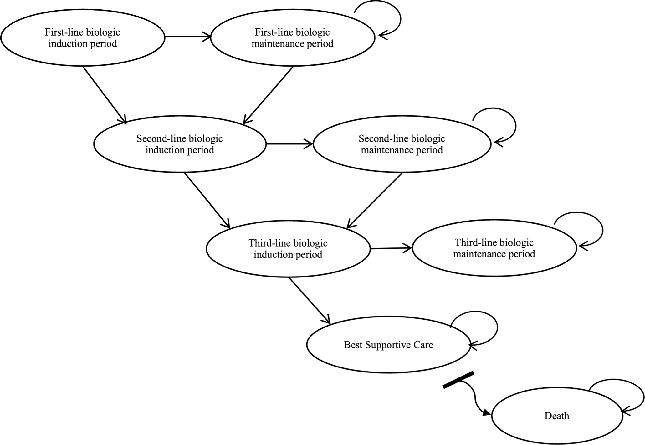
Model Structure in Azizam et al.
The model used in this paper is a Markov
model.
What has changed here is the definition of what each
drug is in a three-line case.

Slide 16
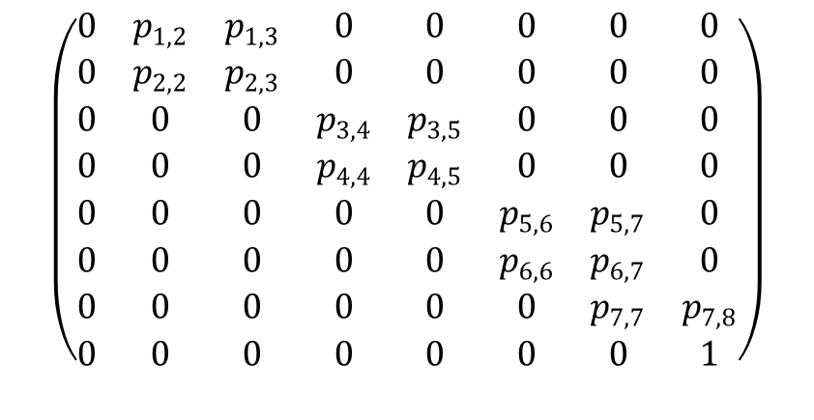
Model Structure in Azizam et al.
The model used in this paper is a Markov
model.
What has changed here is the definition of what each
drug is in a three-line case.
Math Note: The Underlying Markov Matrix is Sparse ( has lots of zeros)
$$\left(\begin{matrix}0 & p_{1,2} & p_{1,3} & 0 & 0 & 0 & 0 & 0 \\ 0 & p_{2,2} & p_{2,3} & 0 & 0 & 0 & 0 & 0 \\ 0 & 0 & 0 & p_{3,4} & p_{3,5} & 0 & 0 & 0 \\ 0 & 0 & 0 & p_{4,4} & p_{4,5} & 0 & 0 & 0 \\ 0 & 0 & 0 & 0 & 0 & p_{5,6} & p_{5,7} & 0 \\ 0 & 0 & 0 & 0 & 0 & p_{6,6} & p_{6,7} & 0 \\ 0 & 0 & 0 & 0 & 0 & 0 & p_{7,7} & p_{7,8} \\ 0 & 0 & 0 & 0 & 0 & 0 & 0 & 1\end{matrix}\right)$$

Slide 17
A warning about sensitivity analysis with different clinical alternatives.
With multiple comparators we need to be sure that they make sense.
  This can require some clinical knowledge about the intensity associated with each treatment.
Example #1: Mesalamine is a “first-line drug” for treating patients with Ulcerative Colitis. We will never see this drug offered after a more complex and costly biologic treatment.
Example #2: Immunotherapy is often not a first line treatment for breast cancer. Assuming it to be used as a first line treatment in a Markov type setup would be incorrect.
Bottom Line: A sensitivity analysis should support your research, if you use scenarios which do not make sense they do not support the case for defing a treatment as cost effective or not.

Slide 18
How many comparators?
Using multiple comparators is one of the strongest ways to support the validity of the cost effectiveness of a new technology or treatment.
But it can get unwieldly for some treatments.
For ulcerative colitis, there are currently 8 different FDA-approved biologic classes of drugs. If we wanted to analyze their sequencing where patients follow 3 different drugs before moving on to some “best standard of care”. There are over 56 possible sequences.
This can get very difficult.
Clinical expertise and thinking about your problem will narrow this number.

Slide 19
Two-Way Sensitivity Analysis

Slide 20
Two Way Sensitivity Analysis
Two-way sensitivity analysis is conducted when we are interested in how two parameters impact the output of a model together.
This is different from one way sensitivity analysis where it is assumed that parameters are independent of eachother.
This analysis is often justified when we suspect that model parameters are correlated with each other (i.e, the varying of one parameter will necessarily impact the value of another).
As an example, health states and the risk of adverse events are often negatively correlated with health utilities. (i.e. lower the utility the higher the probability of an adverse event).

Slide 21
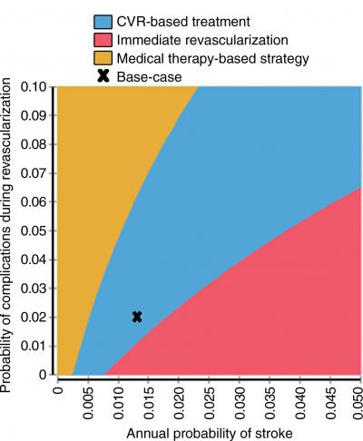
Two way sensitivity analysis plot
In a two way sensitivity analysis we create a strategy selection map.
With this plot we can identify which treatments are cost effective conditional on pairs of parameter values.
The plot’s advantage is that it shows directly how changing the models parameters over a range of values can impact the main results.
A disadvantage is that it can only consider two parameters at a time, while in the one-way analysis we can add every parameter on the same plot.
We also do not get a sense of how the ICER may change across parameters.
Source: Radiological Society of North America
https://www.eurekalert.org/multimedia/920184

Slide 22
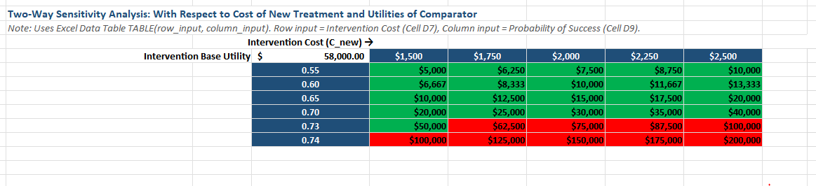
A sketch of two way sensitivity analysis
Sensitivity analysis involves varying the values of two coefficients at the same time and choosing the option with the lower ICER (cost effective) ICER.
NOTE: This assumes that both changes in costs and effects are positive, in the case where we end up with negative ICERS from the sensitivity Analysis we will need to use NET MONETARY BENEFITS or NET HEALTH BENEFITS which is to be discussed.
The more general analyst tool used for two way sensitivity analysis comes from the use of Two way data tables. (The excel sheet for this table has been uploaded to the course site as an example)

Slide 23
Excel Exercise On Two Way Sensitivity Analysis
GO TO THE FILE!

Slide 24
Comments on Deterministic Sensitivity Analysis

Slide 25
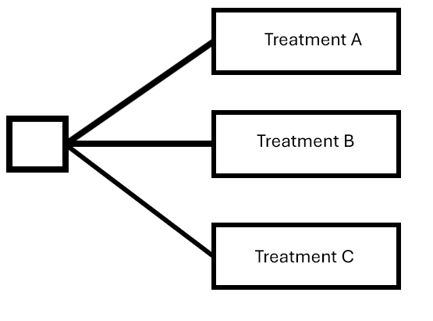
The bare minimum.
If there is Only One Deterministic Sensitivity Analysis that you can conduct, generate a tornado diagram.
They are the most comprehensive and really highlight the limitations.
Two way sensitivity analysis is relevant when there is a concern about correlated parameters, if there isn’t Ignore it.
Multiple comparators are helpful, but be careful when choosing them as the clinical pathway may change for new treatment options and they need to make sense.

Slide 26
Final Remarks on Deterministic Sensitivity Analysis
We started this lecture by stating that the reason for sensitivity analysis is to demonstrate what are the strongest assumptions made about model inputs and structure is to generate our results and how changing those assumptions impact these results.
When we speak to sensitivity analysis we are addressing “worst case scenarios”.
I.e. if the models inputs are incorrect by a margin of over 50% in the case of one way sensitivity analysis this impacts the ICER by increasing/decreasing it by X, which means the treatment is still or no longer is cost effective.
For Input specific sensitivity analysis, there’s really nothing wrong with considering every input and varying them and this is typically what’s included in stronger papers.

